Slide 1
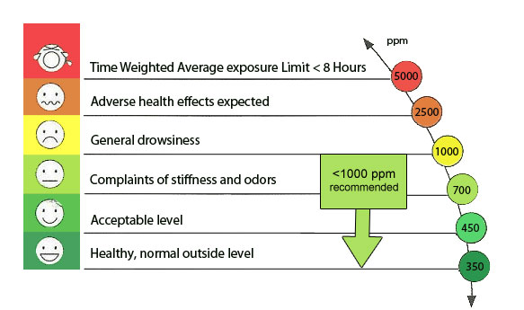
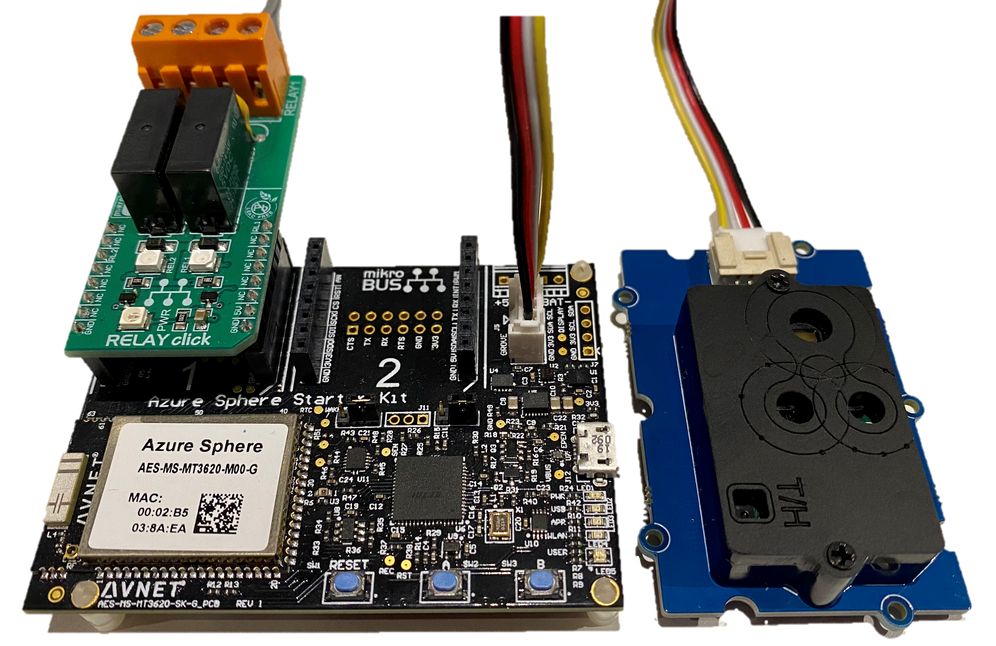
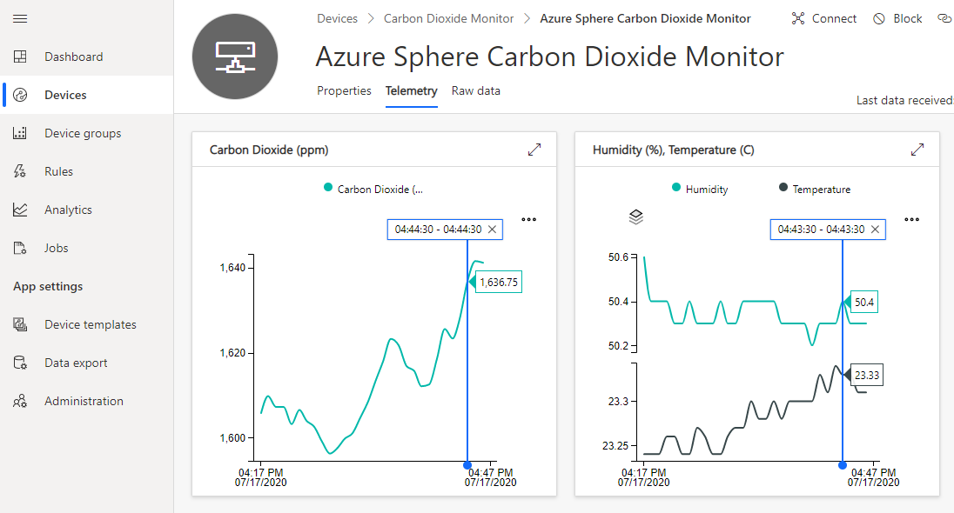
Image source: https://iotfactory.eu/the-importance-of-indoor-air-quality-iaq-for-business-performance-and-wellbeing/

Slide 2
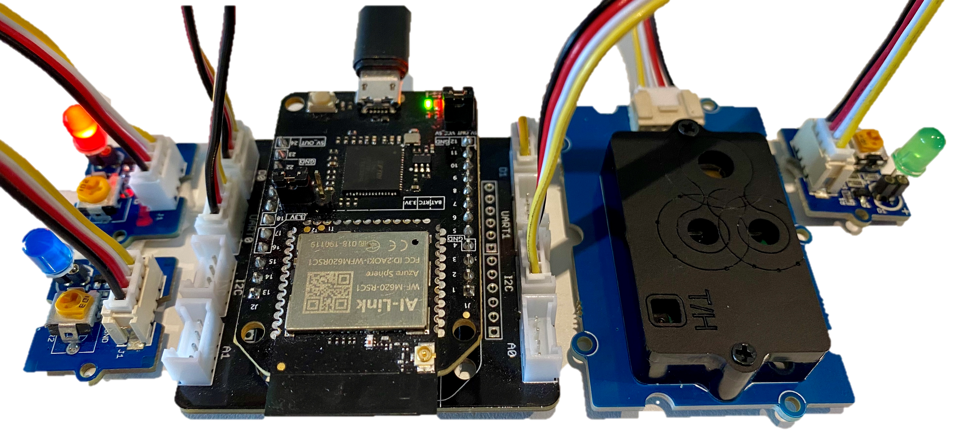
Image source: https://iotfactory.eu/the-importance-of-indoor-air-quality-iaq-for-business-performance-and-wellbeing/

